Slide 1

Tensorflow and Keras
with
Daniel L. Silver, Ph.D.
Andy McIntyre, Ph.D.
June 24, 2022

Slide 2
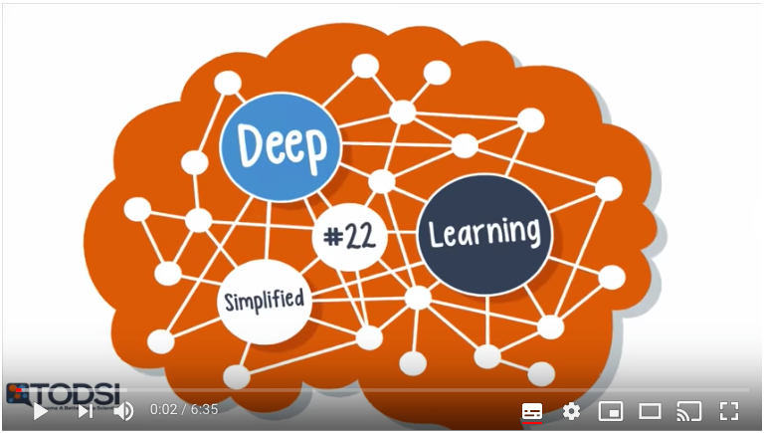
What is tensorflow?
TensorFlow is:
an interface for expressing machine learning algorithms, and
an implementation for executing such algorithms.
symbolic ML dataflow framework that compiles to native CPU -or- fast GPU code
offers a reduction in development time
https://www.youtube.com/watch?v=bYeBL92v99Y

Slide 3
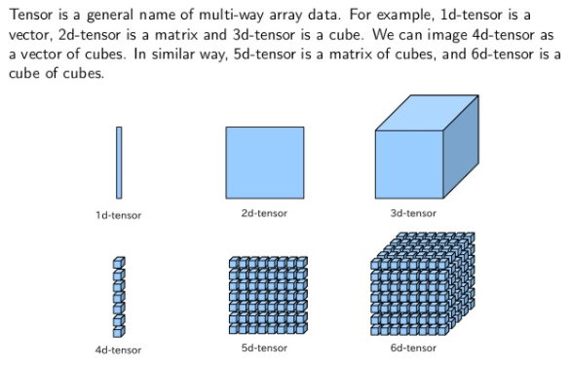
What is a tensor?

Slide 4

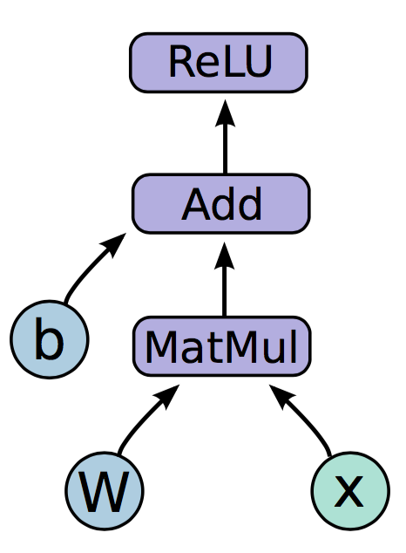
Tensorflow - Programming model
Expresses a numeric computation as a graph.
Graph nodes are operations which have any number of inputs and outputs
Graph edges are tensors which flow between nodes

Slide 5
Tensorflow - Programming model
Basic Flow:
Build a graph
  Contains parameter specifications, model architecture, optimization process, …
Define and initialize a session
Compile and run a session
  Compilation, optimization on CPU or GPU on different operating systems

Slide 6
Tensorflow - Programming model
import tensorflow as tf
b = tf.Variable(tf.zeros((100,)))
W = tf.Variable(tf.random_uniform((784, 100),-1, 1))
x = tf.placeholder(tf.float32, (None, 784))
h_i = tf.nn.relu(tf.matmul(x, W) + b)
1
2
sess = tf.Session()
sess.run(tf.initialize_all_variables())
sess.run(h_i, {x: np.random.random(64, 784)})
3

Slide 7
What is Keras?
A high-level API to build and train deep learning models.
Used for fast prototyping, advanced research, and production, with three key advantages:
  User friendly - simple, consistent interface optimized for common use cases. It provides clear and actionable feedback for user errors.
  Modular and composable - Keras models are made by connecting configurable building blocks together, with few restrictions.
  Easy to extend - write custom building blocks to express new ideas for research, or create new layers, loss functions, and develop new models
http://Keras.io

Slide 8
What is Keras?
Framework on top of TensorFlow
Follows the principle of layers – can stack, split or merge for unique network architectures.
Calculates the connection size between hidden layers based on each layers size.
Allows GPU acceleration with minimal configuration.
http://Keras.io

Slide 9

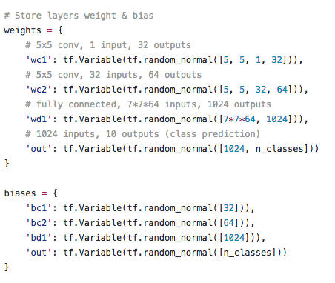
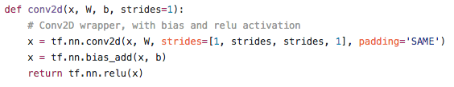

Keras
TensorFlow

Slide 10
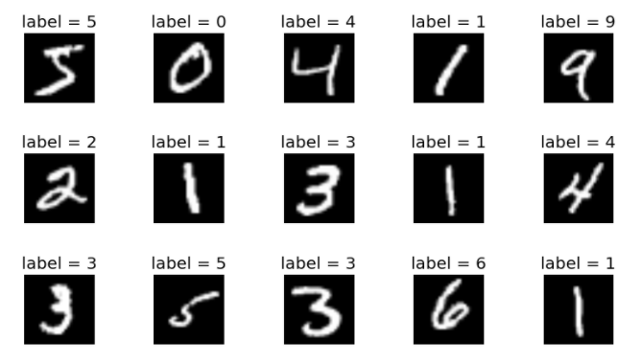
TUTORIAL #1(c)
Let’s try learning a more challenging problem using Tensorflow and Keras (tf.keras_mnist_sigmoid_val.ipynb)
Problem: Classify the MNIST data set examples.
Notes:
OR_and_XOR.py

Slide 11
References
https://www.tensorflow.org/tutorials
https://www.tensorflow.org/api_docs/python/tf/keras
https://opensource.google/projects/tensorflow-playground
https://www.datacamp.com/courses/deep-learning-in-python
https://developers.google.com/machine-learning/crash-course/ml-intro
https://www.coursera.org/specializations/deep-learning

